Slide 1
SURV 727 FINAL Presentation: Public Interest in USDA’s statistical reports
Doug Kilburg and Arthur Rosales

Slide 2
Research Question Review
Is there a strong enough interest in other USDA/NASS’s product releases that would also warrant #StatChat sessions, for non-market traded commodity releases?
17 Product Key phrase searches
"Certified Organic Survey", "Cold Storage Report", "Cattle on Feed", "Rice Stocks", "Crop Progress Report","Local Foods", "Agricultural Prices", "Cattle Survey", "Farm and Ranch Irrigation Survey"*, "Irrigation and Water Management Survey“*, "Cotton Ginnings", "Dairy Products", "Livestock Slaughter", "Grain Crushings", "Hop Stocks","Agricultural Chemical Usage", "Census of Horticulture"
Notes:
*Farm and Ranch Irrigation Survey changed it’s name in 2018 to the Irrigation and Water Management Survey, so both were included.
So there are 16 products, but 17 product phrases.

Slide 3
Actual Sources Used
Twitter timelines of the followers of NASS’s twitter account for the period of November, 2018 to November, 2020.
Subreddits
Farming
Agriculture
Science
Google
Web searches for the titles of our product releases.
News searches for the titles of our product releases.
Notes:
READ the script!
Our sources didn’t change from the midterm presentation; however, we did put in a request to get downloads by survey product to our division that controls our internal dashboard metrics, but we haven’t received that data yet.
One minute ten seconds

Slide 4
Preliminary Results
Results weren’t as plentiful as we initially thought
All sources had at least seven products that returned no search results.
Sources | Number of products with positive “hits” (% of 16) | Product with largest number of “hits” (total hits) | Product with least positive number of “hits” (total “hits”) | Number of Products with at least 15 “hits”
Google Web searches | 10 (62.5%) | Livestock Slaughter (2798) | Agricultural Prices (3) | 9
Google News searches | 5 (31.25%) | Cold Storage (1453) | Crop Progress (76) | 5
Subreddits scraped | 8 (50%) | Dairy Products (4122) | Local Foods (6) | 7
Twitter timelines of our followers | 8 (50%) | Crop Progress (79) | FRIS/IWMS (1) | 3
Notes:
There were records we scraped that weren’t relevant to our products. We tried to exclude these where we could.
It was interesting to see that some sources had one product as the most frequently found product, such as Twitter with the Crop Progress Report, while another source has it as the least referenced product, such as the google news searches. This example is highlighted in green. This reassures us the importance of using multiple sources in tracking interest in our products, and may suggest some heterogeneity among the users of these sources
“Hits” is in quotes since the gtrends function we used in R returns a ‘indexed value’ instead of actual results.
Only if time:
I included the last column due to the twitter results. Despite having 50% of products mentioned in Twitter timelines for the past two years, It was mostly Crop Progress, Cattle on Feed, and Cold Storage reports that were mentioned. All other items were mentioned less than 10 times each in the past two years.

Slide 5
Products with most “hits”
Most popular products across sources
Cold Storage Report
Dairy Products Report
Cattle (and Cattle On Feed (feedlots))
Medium popular products
Crop Progress and Condition Report
Livestock Slaughter Report
Local Foods Report
Notes:
Overall results were mostly consistent across products, especially when the top three products were compared. Our top products across sources make sense since these products are all related.
Cold Storage Report is a monthly report used to indicate how much product is stored in large frozen or refrigerated storage capacity, which may be used to estimate supply of these items. Dairy Products generally represent sales and production of Dairy Products.. Cattle/Cattle on Feed are separate surveys, but measure the same type of commodity. Cattle on Feed measures fattened cattle being prepared to be shipped for slaughter.
We also list the three products with the next highest level of interest, but that were significantly less than the top three.

Slide 6
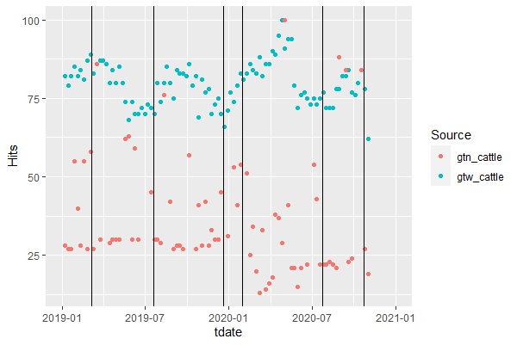
Analysis: Interest over Time
Google Searches for “Cattle Survey” vs NASS Publication Releases

Slide 7
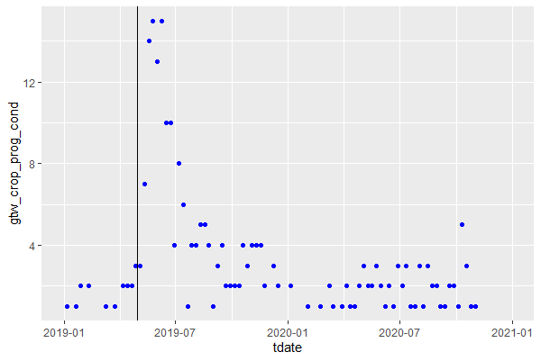
Analysis: Interest over Time
Google Web Searches for Crop Progress and Condition
Heartland
Floods

Slide 8
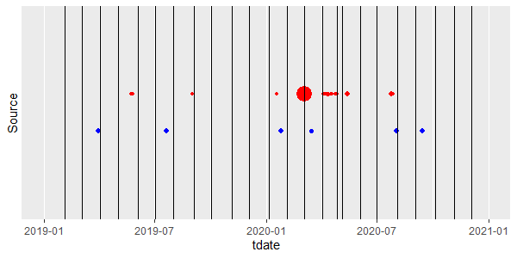
Analysis: Interest over Time
Reddit Discussion vs Google News Searchers of “Dairy Products Survey”
Reddit Discussion
Google News Search

Slide 9
Potential Additional Analysis
IF we acquire NASS download information:
Investigate relationship between downloads and scraped interest?
Factor analysis, reddit, google, twitter combined into single “interest” factor

Slide 10
Takeaways
Keywords are complicated
The Dairy Product Discussion
Given the literal nature of terms used (NASS product names), perhaps sentiment analysis may not have been effective
Knowing which venues to search is complicated
Probably missed plenty of internet discussion on Ag news discussion boards/comments sections, or maybe FarmersOnly.com
Describing a relationship with found data is one thing, but making inferences about “public interest” in the population is another

Slide 11
Future Work
Assuming we actually find an abundance of web discussion about NASS products, sentiment analysis could be employed in the future to understand widely held views. This in turn, could be helpful for NASS PR to target education and outreach efforts

Slide 12
Thank You

